Slide 1

AGB1211 – DESIGN THINKING
Department of Artificial Intelligence and Data Science
Academic Year: 2024 – 2025 (Odd Semester)
Year
Semester
Section
Date
:
:
:
:
II
III
B
06.12.2024
PRESENTED BY,
SUJITHA G(2303811724322113)
SUJITHA R S(2303811724322114)
TAMILDEEPAA A(2303811724322116)
GUIDED BY,
JOANY FRANKLIN M.E.,
Assistant Professor,
Department of AI,
K.Rmakrishnan college of technology.
1
AGB1211 – DESIGN THINKING

Slide 2
Title of the Project
ATTENDANCE MONITORING
AND DISCIPLINARY
ACTION IN COLLEGE
2
AGB1211 – DESIGN THINKING

Slide 3
Problem Identification
Traditional attendance and disciplinary management methods have several drawbacks. Manual processes are slow, prone to human errors, and difficult to manage, especially for large student populations. Students and parents often lack timely updates on attendance status or disciplinary actions, leading to communication gaps. Additionally, paper-based systems increase administrative workload, risk data loss, and delay action on absenteeism or misconduct. These inefficiencies highlight the need for a digital solution to streamline these processes effectively.
3
AGB1211 – DESIGN THINKING

Slide 4
Objective
The objective of this project is to develop a mobile application that simplifies attendance monitoring and disciplinary action management in colleges. The app aims to replace traditional manual methods with a digital system to ensure accuracy, reduce errors, and save time. It seeks to improve communication by providing timely updates to students and parents about attendance and disciplinary records. Additionally, the app will streamline disciplinary processes, reduce administrative workload, and promote accountability by maintaining transparent and easily accessible records. The system aims to create a more efficient and organized academic environment.
4
AGB1211 – DESIGN THINKING

Slide 5
BrainStorming
Attendance software >Automated alerts >Absenteeism tracking >Compliance >Penalties >Rewards >Real-time monitoring >Parent notifications >Classroom engagement
>Behavior alanalysis
Historical data >Academic performance >Student IDcards
> Check-in/check-outsystems
>Time management
>Data privacy.
>Reporting tools
>Administrative dashboards
>Student behavior patterns
5
AGB1211 – DESIGN THINKING

Slide 6
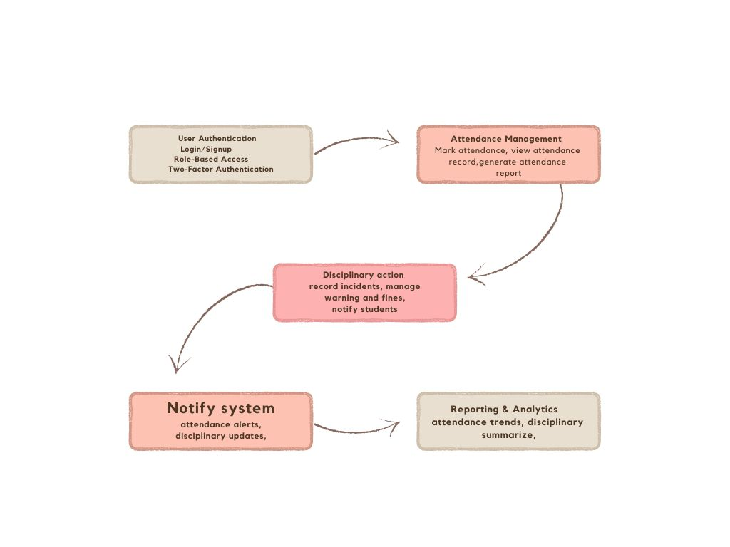
Mind Map
6
AGB1211 – DESIGN THINKING

Slide 7
Primary Research
Primary research focuses
information from users:
Interaction with User: Talk to students, faculty, and administrators to understand their needs.
Surveys: Collect data about current challenges with attendance and disciplinary management .
Prototype Testing: Use Proto.io to test an app prototype with real users and gather feedback.
7
AGB1211 – DESIGN THINKING

Slide 8
Secondary Research
Secondary research involves studying existing materials and systems:
Literature Review: Study articles and research papers about attendance anddisciplinary systems.
Competitor Analysis: Analyze similar apps to learn their strengths and weaknesses.Proto.io Guides: Use Proto.io tutorials to create effective prototypes.
8
AGB1211 – DESIGN THINKING

Slide 9
Proposed Work
Steps to build the app:
Requirement Gathering: Collect user needs from interviews and surveys.
Prototyping: Create an interactive app prototype using Proto.io.
Development: Build the app based on the finalized prototype.
Testing: Test the app with users to ensure functionality and ease of use.
Deployment: Launch the app and update it based on user feedback..
9
AGB1211 – DESIGN THINKING

Slide 10
List of Modules
1. USER AUTHENTICATION
2.ATTENDANCE MANAGEMENT
3. DISCIPLINARY ACTION MODULE
4. NOTIFICATION MODULE
5. REPORT AND ANALYTICS
10
AGB1211 – DESIGN THINKING

Slide 11
Module 1 Description
User Authentication: Enables login for students, faculty, and administrators.
Faculty: Mark attendance and manage disciplinary actions.
Admins: Oversee attendance and disciplinary data for all users.
11
AGB1211 – DESIGN THINKING

Slide 12
Module 2 Description
Attendance Management: Faculty Module: Mark attendance manually for each class, Edit attendance records as needed.
Admin Module:
Monitor attendance across departments, Generate attendance reports for auditing.
12
AGB1211 – DESIGN THINKING

Slide 13
Module 3 Description (Cont..)
Disciplinary Action Module: Faculty can record incidents and assign actions like warnings or fines. Students can view disciplinary actions and respond (if applicable).
Administrators can review all disciplinary records for transparency.
13
AGB1211 – DESIGN THINKING

Slide 14
Module 4 Description (Cont..)
Notification System: Alerts for students with low attendance.
Notifications for disciplinary actions or updates.
System-wide announcements from administrators
14
AGB1211 – DESIGN THINKING

Slide 15
Module 5 Description (Cont..)
Reporting & Analytics: Generate attendance reports by class, batch, or student. Visualize trends in attendance (e.g., low-performing students). Review disciplinary statistics for decision-making
15
AGB1211 – DESIGN THINKING

Slide 16
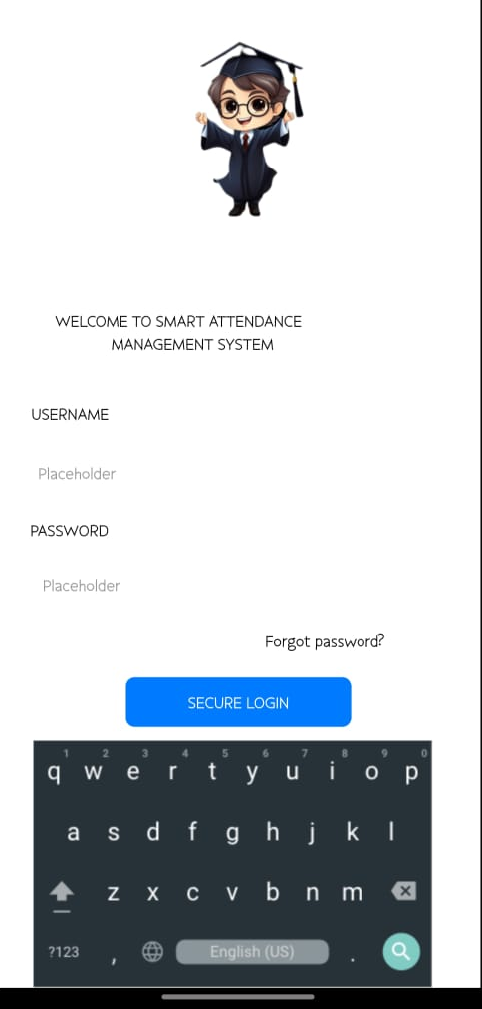
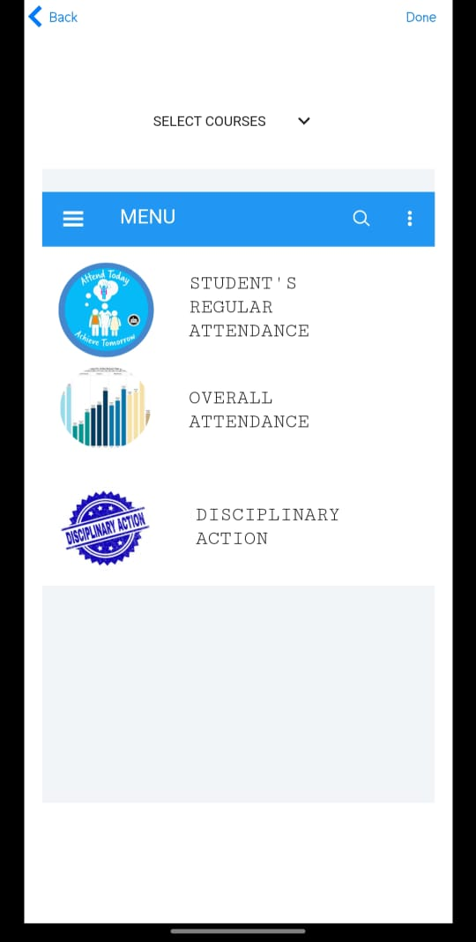
Results
16
AGB1211 – DESIGN THINKING

Slide 17
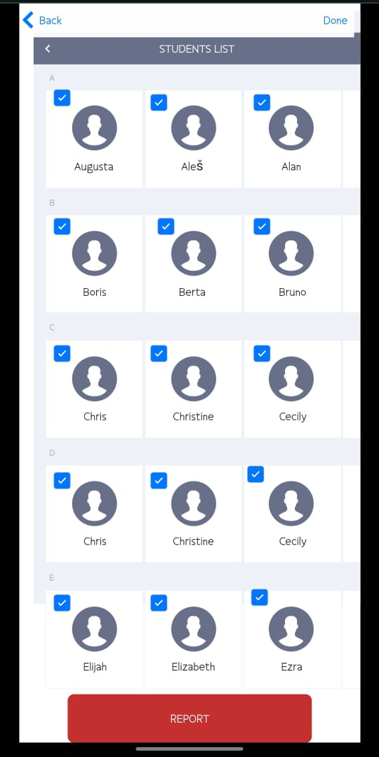
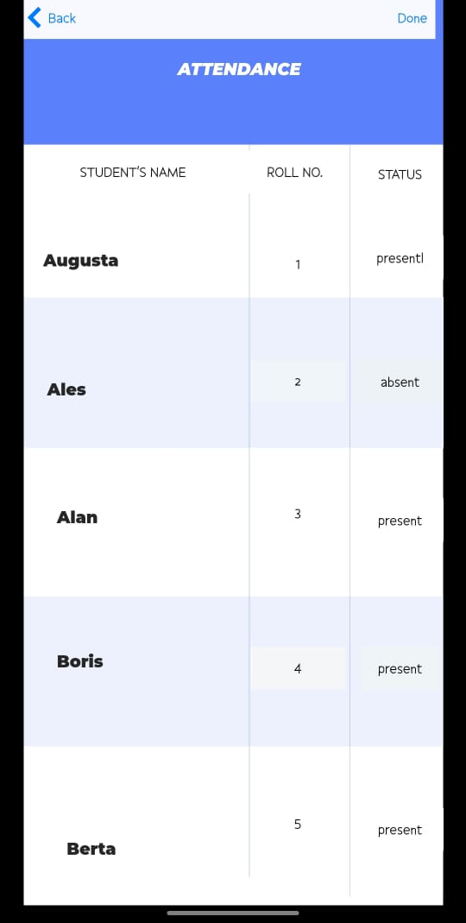
Results
17
AGB1211 – DESIGN THINKING

Slide 18
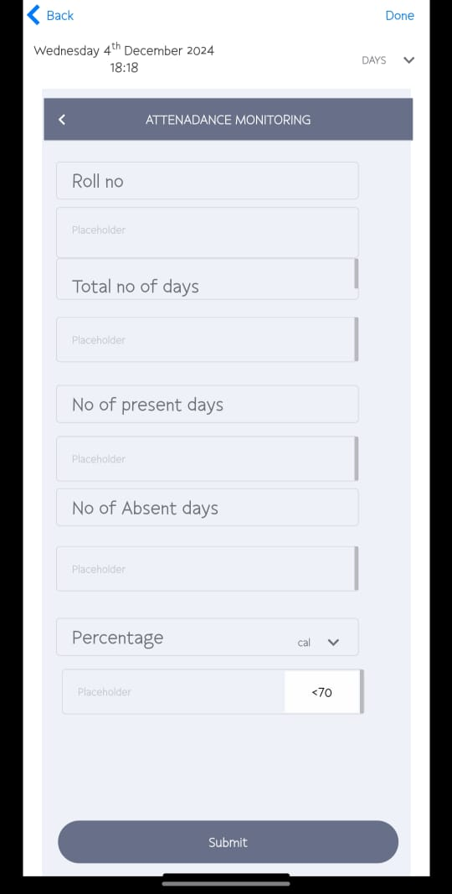
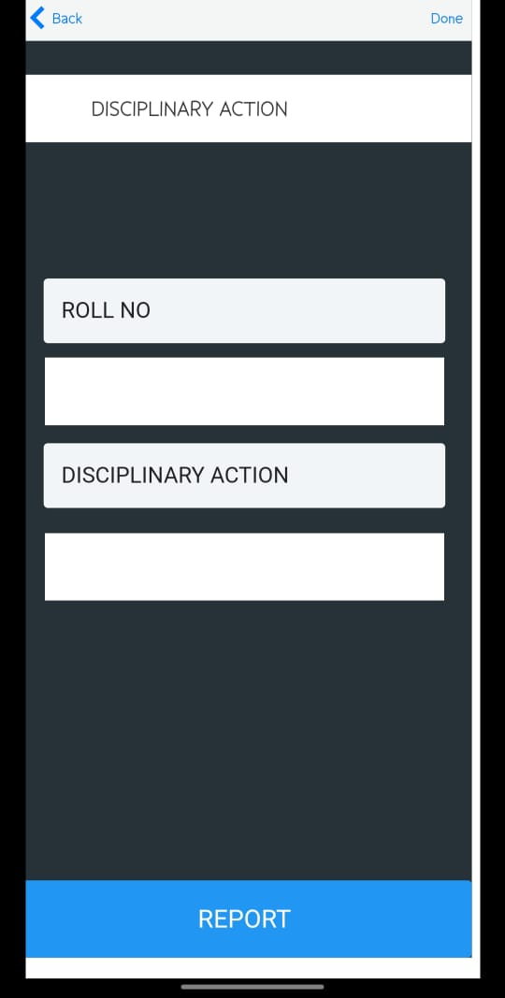
Results
18
AGB1211 – DESIGN THINKING

Slide 19
Conclusion
The Attendance Monitoring and Disciplinary Action Mobile App offers a streamlined, secure, and efficient way to manage student attendance and disciplinary records in a college environment. By integrating features such as real-time notifications, role-based access, and automated reporting, the app enhances transparency and accountability for students, faculty, and administrators.
Prototyped using Proto.io, the app ensures a user-friendly interface and seamless functionality tailored to the needs of its users. This system simplifies administrative processes, promotes better communication, and ensures timely action, contributing to an organized and well-regulated academic environment
19
AGB1211 – DESIGN THINKING

Slide 20
Thank You
ANY QUERIES???
20
AGB1211 – DESIGN THINKING

